Slide 1
Week 7
COGS 108 SP 2026
*By: Jason Chen & Jessica Cheng, Spring 2026

Slide 2
Due dates
Data Checkpoint: Wednesday (05/13)
D6: Friday (05/15)

Slide 3
Data Checkpoint
Address proposal feedback in the checkpoint
Proposal grade will be adjusted if issues are addressed

Slide 4
Models: Evaluation Metric
Metric | Penalizes Complexity? | Main Purpose | Key Idea | Better Value
Adjusted R-squared | Yes | Compare regression models with different numbers of predictors | Adjusts R² by penalizing unnecessary variables | Higher is better
R-squared | No | Measure how much variance the model explains | Usually increases when predictors are added, even if they are useless | Higher is better
BIC | Strongly | Model selection and overfitting control | Strong penalty for adding more parameters | Lower is better
Durbin-Watson | No | Check residual independence | Detects autocorrelation in residuals, not model complexity | Closest to 2 is best
Notes:
A simple model can be written as outcome equals intercept plus slope times predictor.
The intercept anchors the model. The slope tells us the expected change in the outcome for a one-unit change in the predictor.
For multiple regression, we interpret one predictor while holding the other predictors constant.
When you explain a regression result, start by naming the outcome. Then name the predictor. Then state the unit of change. Also avoid causal language unless the study design actually supports causal claims.

Slide 5
Models: Regression Interpretation
Focus on what each part of a fitted model means.
Model form
Interpretation habit
outcome = intercept + slope × predictor
Name the outcome first.
Name the predictor second.
State the unit of change.
Avoid causal language unless the design supports it.
The intercept anchors the model.
The slope represents the expected change in the outcome for a one-unit change in the predictor.
Multiple regression interprets one predictor while holding the others constant.
Notes:
Adjusted R-squared penalizes model complexity. It is useful when comparing regression models with different numbers of predictors. A higher adjusted R-squared is generally better.
R-squared does not penalize complexity. It measures how much variance the model explains. However, it can increase when more predictors are added, even if those predictors are not useful.
BIC strongly penalizes model complexity. It is used for model selection and overfitting control. A lower BIC is generally better.
Durbin-Watson is different. It does not measure model complexity. It checks whether residuals are independent. A value close to 2 is usually best.

Slide 6
Models: Transformations & Diagnostics
Think about why a model may or may not be interpretable.
Transform
Diagnose
Sanity check
Transformations can make skewed variables easier to model.
Diagnostics ask whether model assumptions are plausible.
Sanity checks ask whether the variables and data-generating story make sense.
A low-quality measurement can make a statistically neat model useless.
Notes:
Transformations can help when variables are skewed or when variability changes across the range of the data. A log transformation is a common example.
Diagnostics help us check whether model assumptions seem reasonable.
Sanity checks are also important. Even if a model looks statistically clean, it can still be meaningless if the measurements are poor or if the data-generating story does not make sense.
The key point is this: a low-quality measurement can make a statistically neat model useless.

Slide 7
Model Complexity: Fit vs. Simplicity
More predictors can improve apparent fit, but not always the model you should prefer.
In-sample fit
Some metrics mostly ask: “How close did the model fit the observed data?”
These metrics can improve when the model becomes more flexible.
Fit
better prediction of seen data
vs
Complexity penalty
Simplicity
Other metrics ask: “Did the better fit justify the extra parameters?”
These metrics help discourage unnecessary complexity.
fewer unnecessary parameters
Notes:
More predictors can improve how well a model fits the data we already observed. This is called in-sample fit.
However, better fit on observed data does not always mean the model is better. A model can become too flexible and start fitting noise.
Complexity penalties help us ask a different question. They ask whether the improvement in fit is worth the extra parameters.
This is why model selection often balances two goals: good fit and unnecessary complexity control.

Slide 8
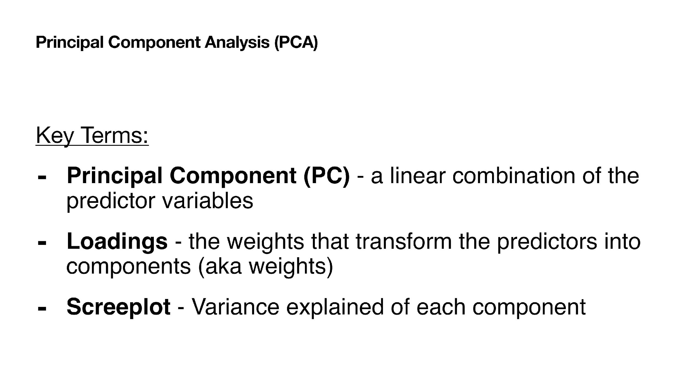
Dimensionality Reduction: PCA Core Ideas
PCA turns many numeric variables into fewer components.
A principal component is built from the original variables.
Loadings are the weights used to form each component.
Components are ordered by how much variance they capture.
PCA is linear, so it works best when linear projections are useful.
Notes:
PCA is a dimensionality reduction method. It turns many numeric variables into fewer components.
A principal component is built from the original variables. It is not usually just one original feature. It is a weighted combination of features.
The loadings are the weights used to form each component.
The components are ordered by how much variance they capture. The first component captures the most variance. The next component captures the next most variance, while staying uncorrelated with the previous component.
PCA is linear. This means it works best when linear projections are useful for the data.

Slide 9
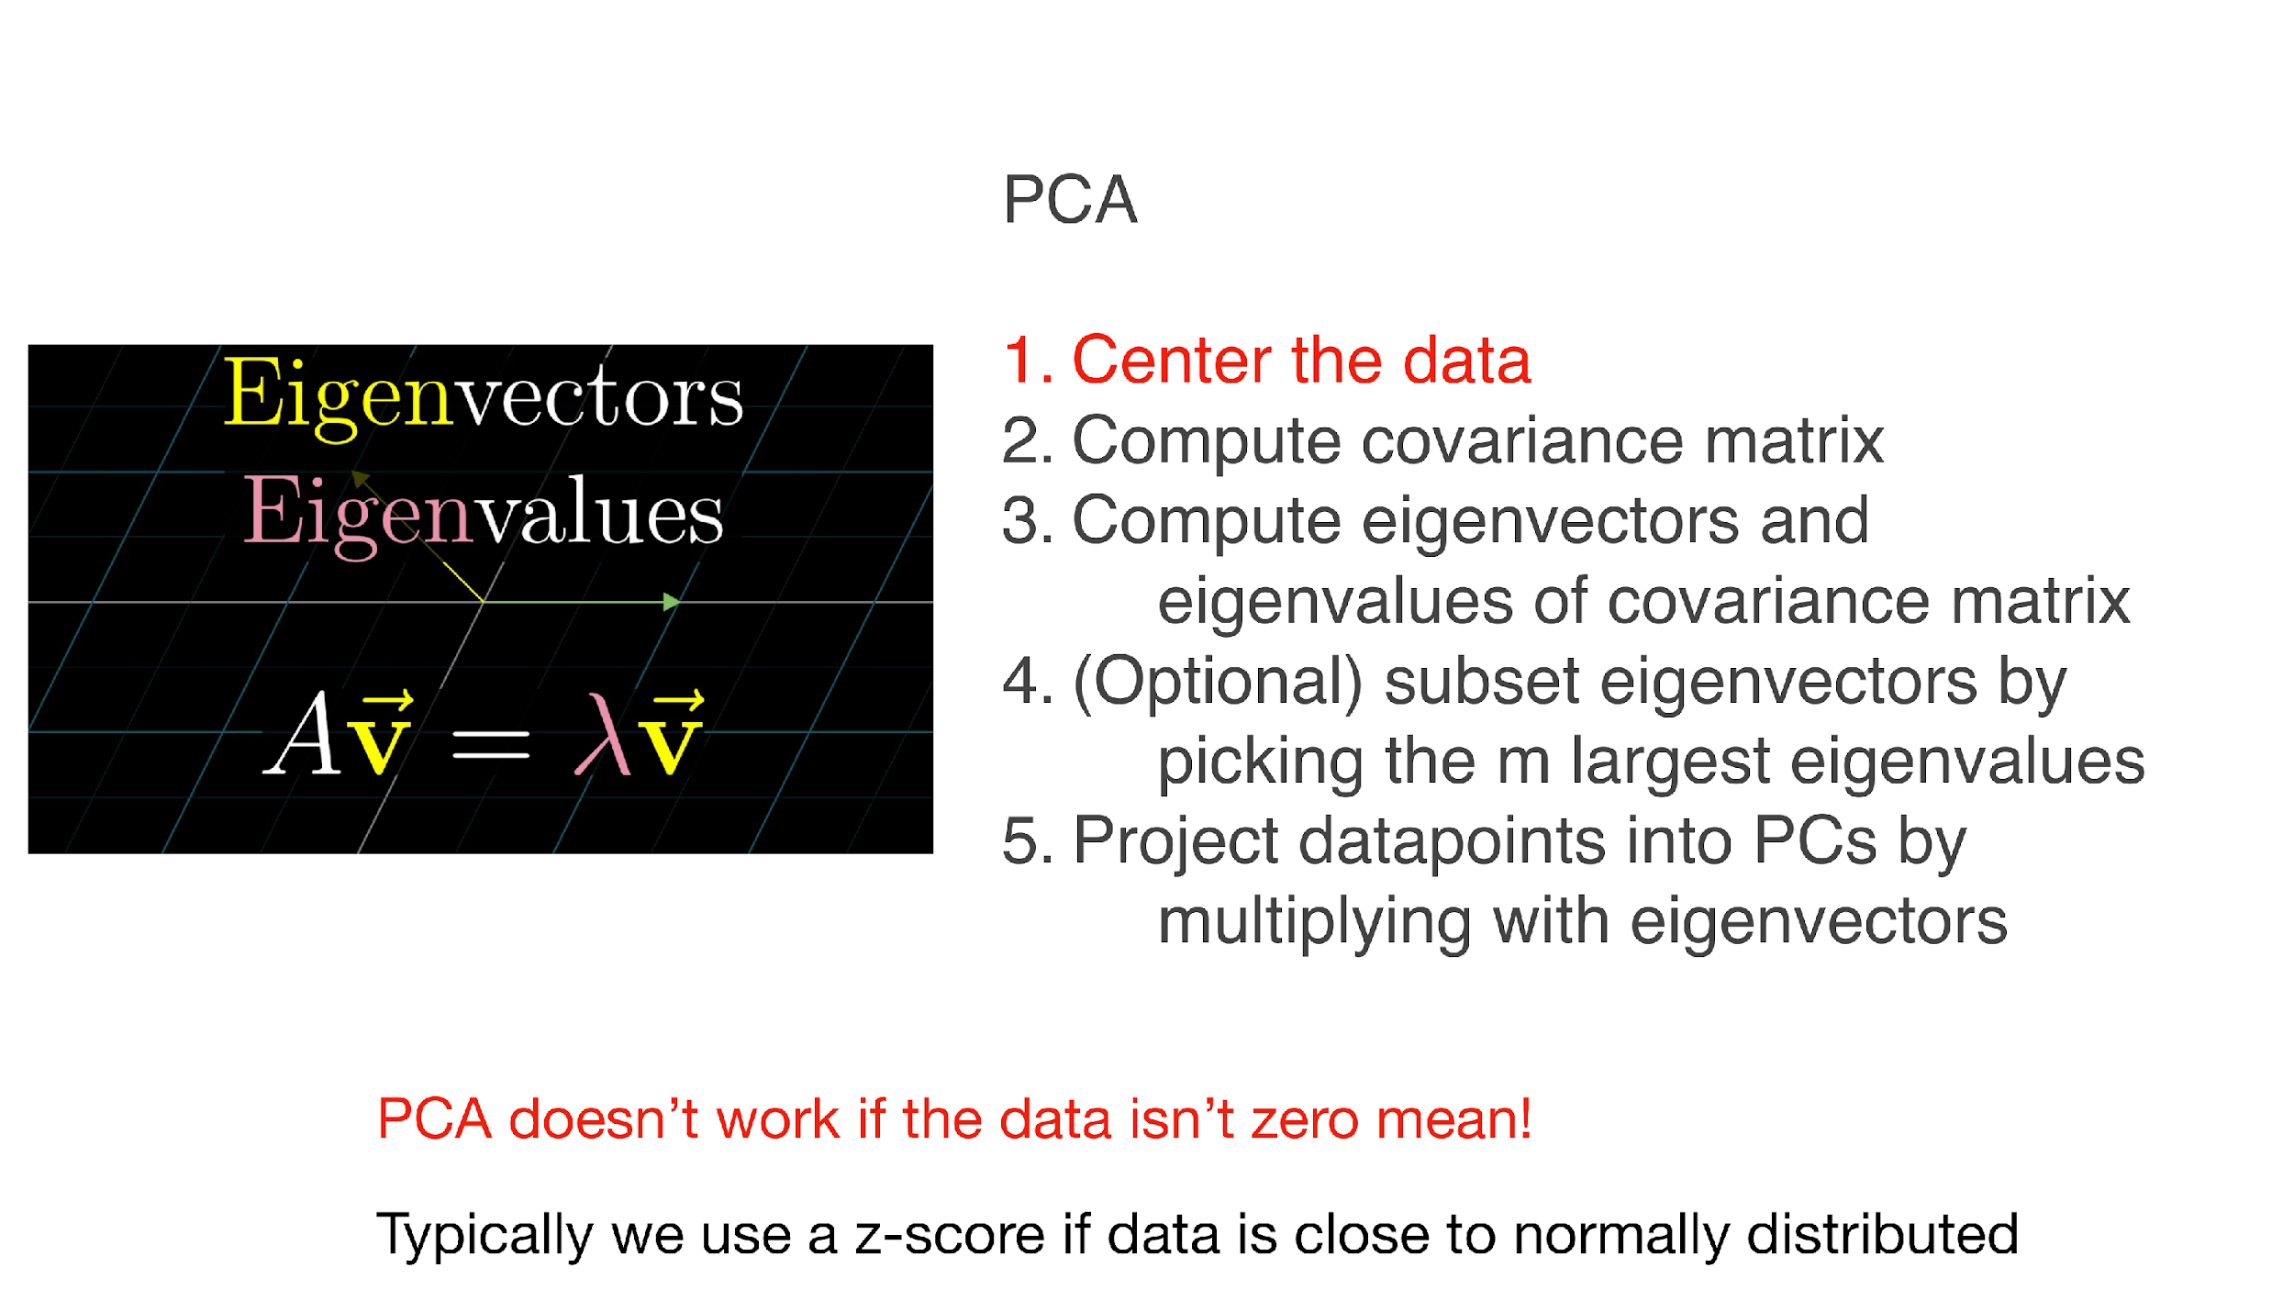
PCA Workflow: From Data to Components
The workflow matters because PCA is sensitive to scaling and centering.
Notes:
PCA is sensitive to centering and scaling. This is why we usually center the data first, and often standardize variables if they are on different scales.
A scree plot shows how much variance each component explains. We often look for an elbow in the scree plot. The elbow helps us decide how many components may be useful.
Loadings help with interpretation. They tell us which original variables contribute strongly to each component.
Choosing the number of PCs is a balance. Too few components may lose important information. Too many components may keep noise or unnecessary complexity.

Slide 10
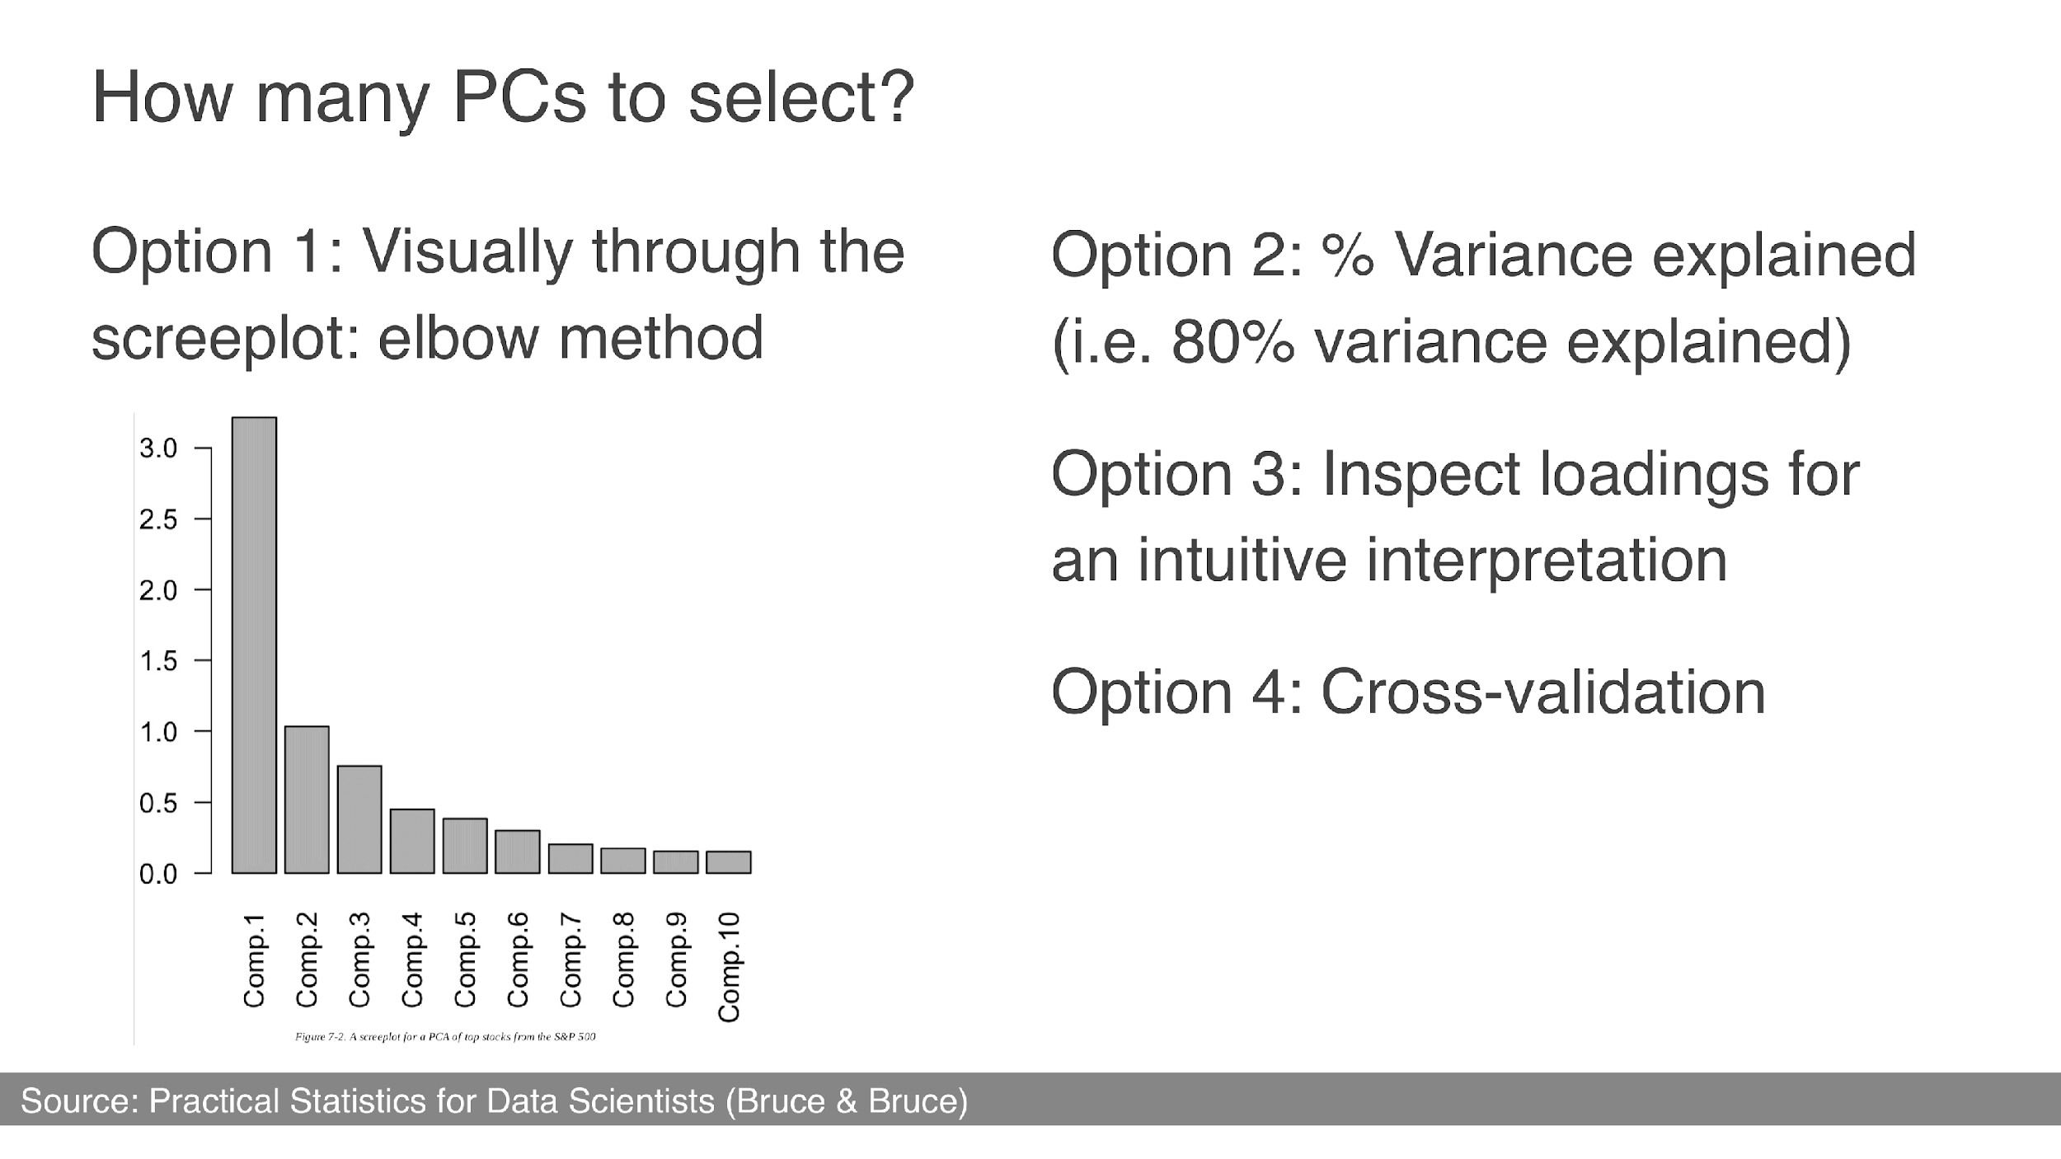
PCA Workflow: From Data to Components
The workflow matters because PCA is sensitive to scaling and centering.

Slide 11
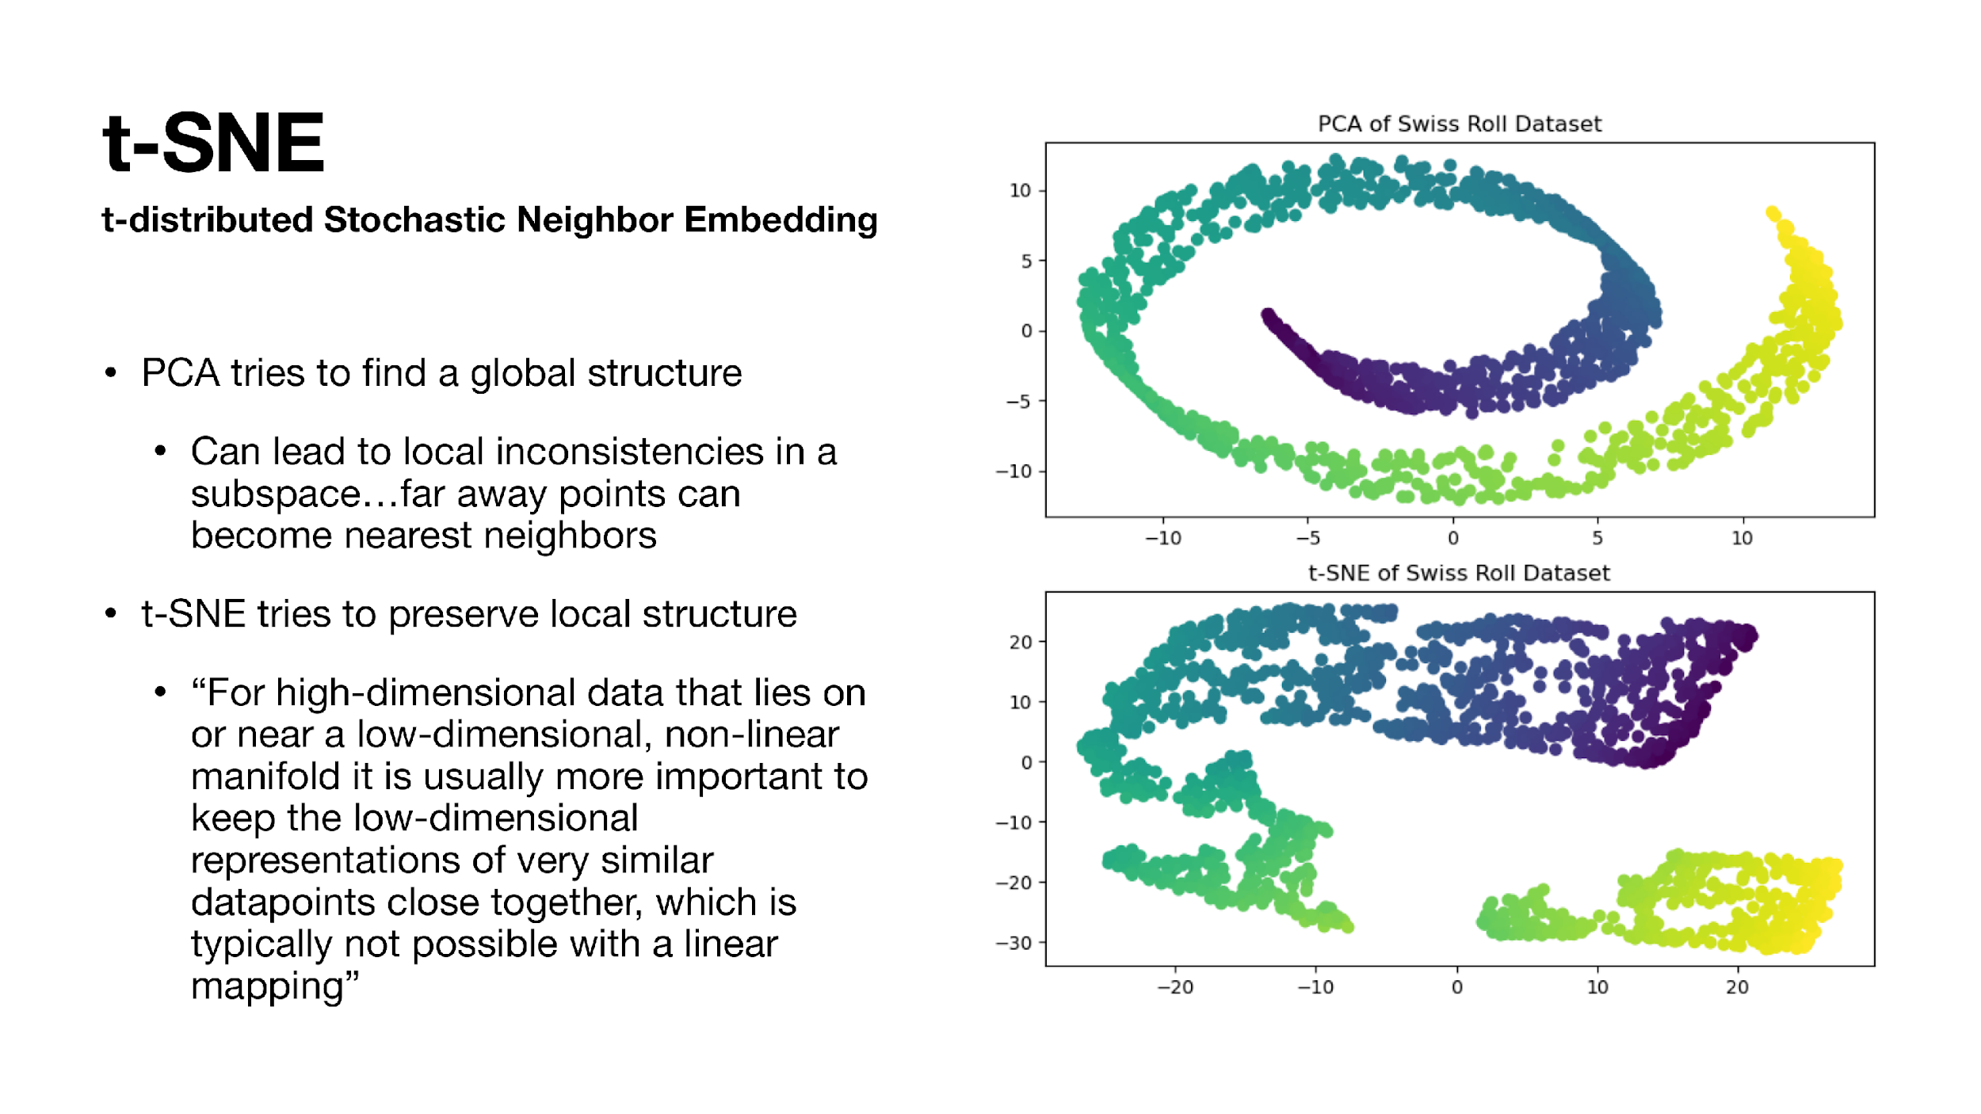
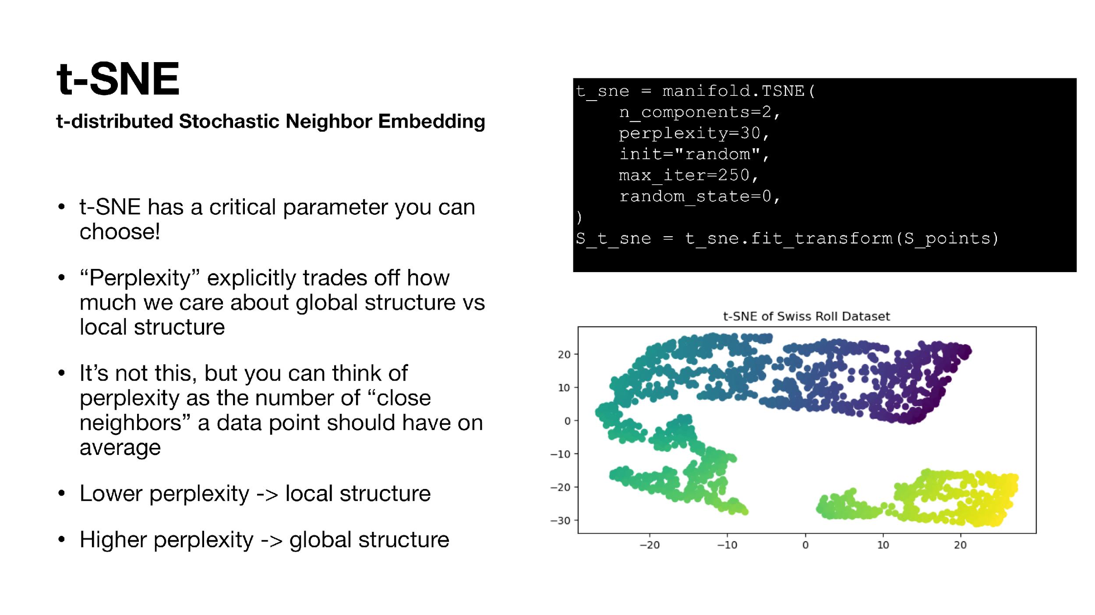
Manifold Learning & t-SNE
When linear projection is not enough, local neighborhoods become the focus.
t-SNE local-structure idea
Perplexity tradeoff
Manifold learning looks for lower-dimensional structure inside high-dimensional data.
t-SNE emphasizes nearby points staying nearby.
Perplexity changes the local-versus-global emphasis.
Visual clusters should be interpreted carefully.
Notes:
Manifold learning looks for lower-dimensional structure inside high-dimensional data.
t-SNE is different from PCA because it focuses more on local neighborhoods. It tries to keep nearby points nearby in the lower-dimensional visualization.
Perplexity is an important t-SNE hyperparameter. It changes the balance between local and more global structure.
The main caution is interpretation. Visual clusters in t-SNE can be helpful, but they should not be overinterpreted. A t-SNE plot is mainly an exploratory visualization, not final proof of separate groups.

Slide 12
Machine Learning Workflow
Prediction requires a workflow that protects against overfitting.
1. Data Partitioning
Split data into:
Training set, Validation set, Test set
Prevents information leakage
2. Feature & Model Selection
Select useful features
Choose appropriate model architecture
Decisions should rely only on training/validation data
3. Hyperparameter Tuning
Optimize parameters such as:
learning rate
number of neighbors (K)
tree depth
Never tune directly on the test set
4. Model Assessment
Evaluate final performance on held-out test data
Measures generalization to unseen samples
Notes:
Prediction requires a workflow that protects against overfitting.
First, we partition the data before model assessment. This helps us evaluate whether the model can generalize to new data.
Second, we select features and model types using training or validation logic.
Third, we tune hyperparameters without touching the final test set.
Finally, we assess generalization on held-out data.
Also remember that prediction is not the same as explanation. A model can predict well even if it does not provide a clean causal story.

Slide 13
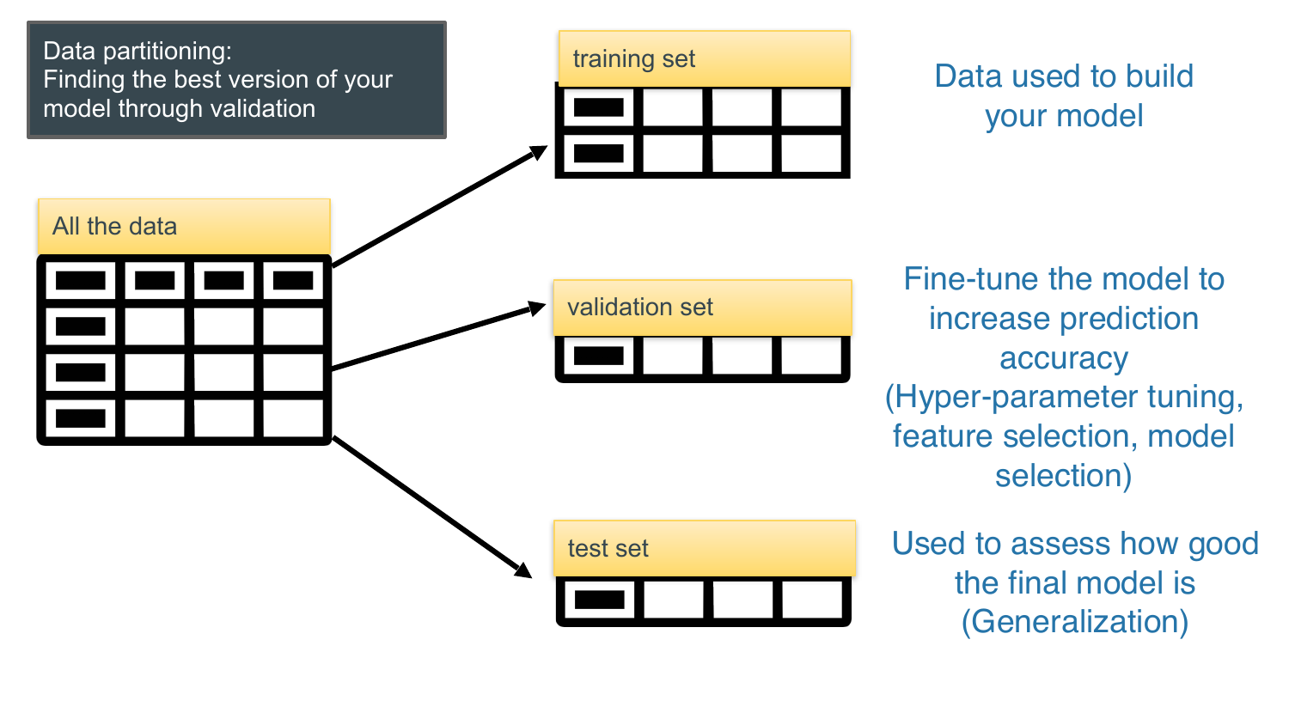
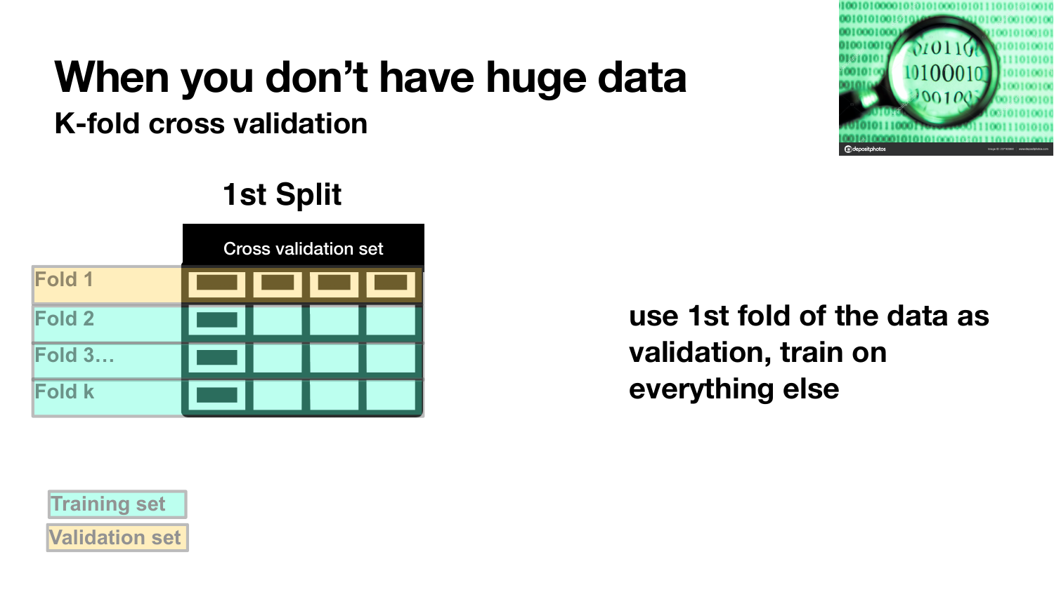
Data Partitioning & Cross-Validation
Separate model building, model tuning, and final model assessment.
Train / validation / test split
K-fold cross-validation
Training set: fit the model.
Validation set: tune or choose among models.
Test set: estimate final generalization.
K-fold CV reuses limited data more efficiently by rotating the validation fold.
Notes:
This slide separates three ideas: model building, model tuning, and final model assessment.
The training set is used to fit the model.
The validation set is used to tune hyperparameters or choose among models.
The test set is used only at the end to estimate final generalization.
K-fold cross-validation is useful when data is limited. It rotates which fold is used for validation, so each part of the data gets used as validation once. Then we average the validation performance across folds.

Slide 14
Learning Modes & Classification Metrics
Before choosing a metric, identify the task and the error you care about.
Supervised Learning
Unsupervised Learning
Use labeled data
Learns relationship between features and known targets
Goal is prediction/classification
Has ground truth labels during training
Examples: Linear Regression, Logistic Regression, SVM, Random Forest
Use unlabeled data
Finds hidden structure or patterns in data
Goal is discovery, grouping, or dimensionality reduction
No ground truth labels provided
Examples: K-means, PCA, t-SNE, Hierarchical Clustering
Supervised learning learns from known answers.
Unsupervised learning tries to discover patterns without answers.
Notes:
Supervised learning uses labeled data. The model learns from known targets. Examples include linear regression, logistic regression, SVM, and random forest.
Unsupervised learning uses unlabeled data. The goal is to find hidden structure or patterns. Examples include k-means, PCA, t-SNE, and hierarchical clustering.
The key distinction is whether the model has known answers during training. Supervised learning learns from known answers. Unsupervised learning tries to discover patterns without known answers.

Slide 15
Learning Modes & Classification Metrics
Before choosing a metric, identify the task and the error you care about.
Classification metric questions
Are the labels known during training?
Is the task classification or regression?
Are the classes balanced?
Which mistake is more costly: false positive or false negative?
Would raw accuracy hide poor performance on the rare class?
Metric choice should match the decision problem.
Notes:
Before choosing a classification metric, we need to understand the task.
Ask whether the labels are known during training. Ask whether the task is classification or regression. Ask whether the classes are balanced.
Also ask which mistake is more costly: a false positive or a false negative.
Accuracy can be misleading when one class is rare. A model can look accurate overall while performing poorly on the rare class.
The main point is that the metric should match the decision problem.

Slide 16
Academic Integrity Reminder for Quizzes
Quiz activity and LockDown Browser logs are monitored.
Suspicious activity has been recorded.
Do not cheat in any form, including:
using AI/notes
sharing codes or answers
communicating with others
taking the quiz outside section.
Further violations will be reported to the Academic Integrity Office.
Notes:
We have been monitoring quiz activity through the backend system and reviewing LockDown Browser logs.
We have noticed several suspicious activities, and these records have been saved.
Please remember that cheating is not allowed in any form. This includes, but is not limited to:
Leaving section after seeing the quiz access code
Completing the quiz outside of section
Using AI tools, outside notes, or other unauthorized resources
Talking or communicating with other students during the quiz
Sharing quiz information, access codes, or answers with others
Quizzes must be completed independently, during section, and under the required quiz conditions.
Any further suspicious behavior may be reported to the Academic Integrity Office.

Slide 17
Quiz Time
NO Phone, NO Communication, No Notes
Access Code: springsteen

Slide 18
Your time to …
Work on projects
Finish Checkpoint
Finish D6
Have fun...

